Slide 1

TimeTable Publisher
Frank Purcell
May 14, 2008

Slide 2
Presentation Overview
What is TimeTable Publisher
Installation
TimeTable Configuration
Quick Look at Other TTPUB Tools
Questions?

Slide 3
What it TimeTable Publisher
System that produces transit time tables in various output formats (xml, pdf, html, etc…).
Raw scheduling data requires preparation for public use that is normally a very tedious and time-consuming manual process for most transit agencies.
The TimeTable Publisher is a single system that takes raw scheduling data as input from various sources, and outputs timetables into various formats for public use.

Slide 4
Information Flow
Raw
Schedule
Data
TimeTable
Configuration
Schedule
Writer
Marketing
TimeTable Publisher
WEB
PRINT PRODUCTION
HTML
PDF
PDF
Proofing
MS Excel
Adobe
InDesign XML

Slide 5
Installation
Install Java JDK – grab latest Java SE installer from java.sun.com (jdk 6 update 5)
Install Apache Tomcat – grab latest installer from tomcat.apache.org (apache-tomcat-6.0.16.exe)

Slide 6
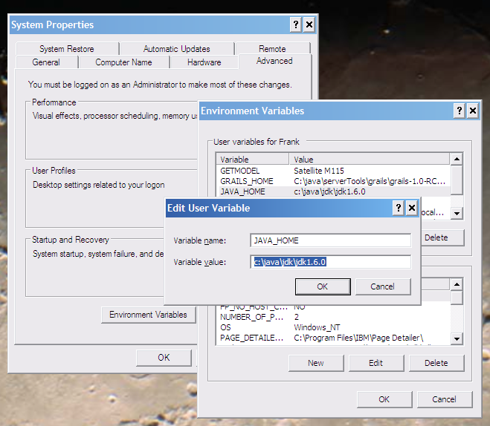
Set JAVA_HOME
Make sure the JAVA_HOME environment variable is set

Slide 7
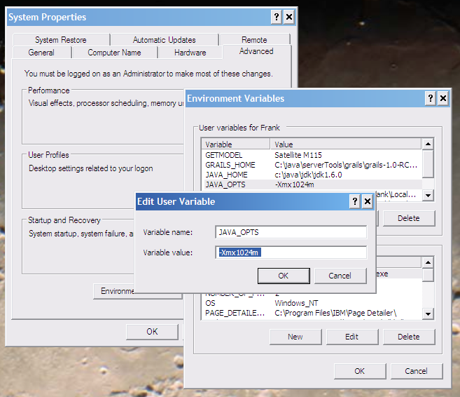
Set JAVA_OPTS
Make sure the JAVA_OPTS environment variable will allocate enough memory for Java

Slide 8
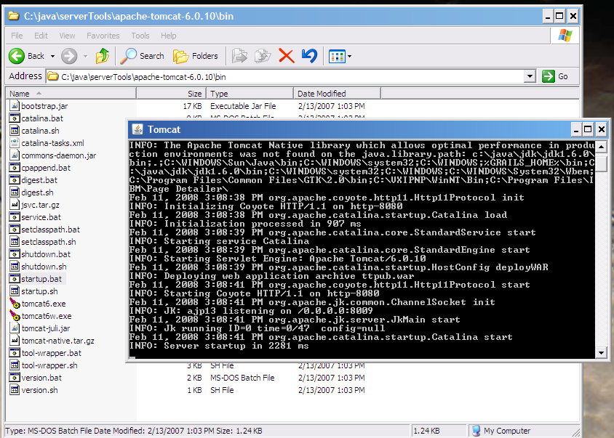
Startup Tomcat

Slide 9
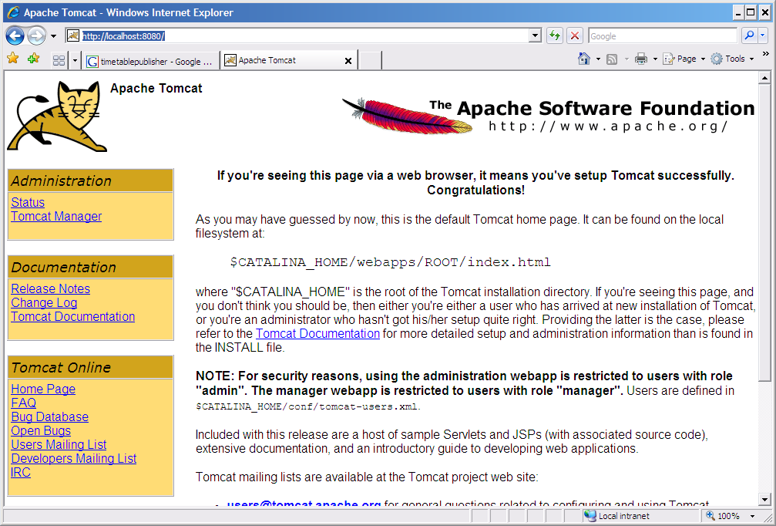
Browse to http://localhost:8080

Slide 10
Install TTPUB
Grab the latest ttpub.war file from timetablepublisher.org
Copy ttpub.war to TOMCAT’s webapps directory
Copy you schedule data to c:/tmp/GTFS
NOTE: your GTFS data really needs route directionality (direction_id) in the trips.txt.
@see GTFS website for more information.

Slide 11
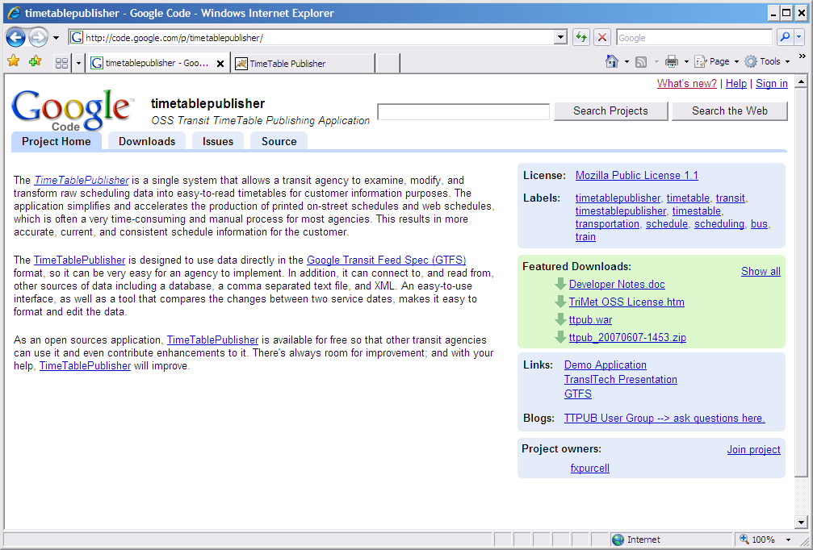
TimeTablePublisher.org
Download ttpub.war to your local computer.
Install by dropping into Tomcat’s webapps directory.

Slide 12
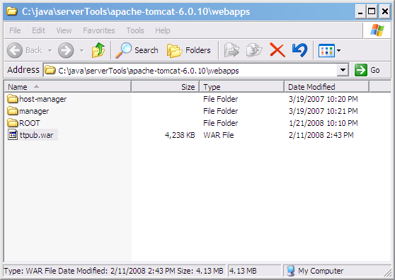
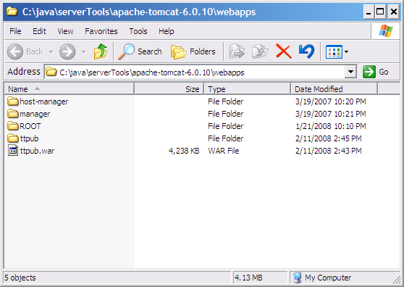
ttpub.war → webapps/ttpub
Tomcat will expand ttpub.war into a ttpub directory.

Slide 13
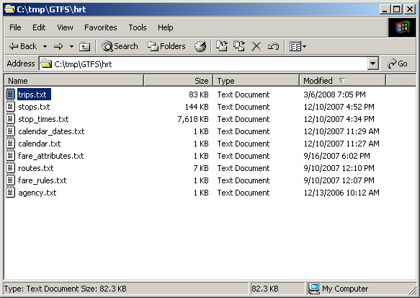
GTFS Schedule Data
Have GTFS data available in c:\tmp\GTFS directory.
NOTE: optional route_dir field in trips.txt is essential for proper ttpub operation.

Slide 14
Pause to catch breath…
…transition to live demo of TTPUB
NOTE: F5 key

Slide 15
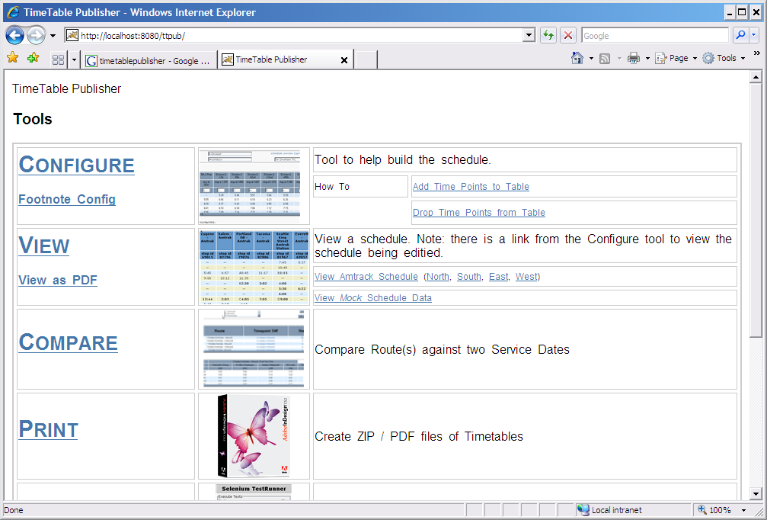
Running TTPUB
http://localhost:8080/ttpub
Once running within tomcat, browse to ttpub’s main screen.

Slide 16
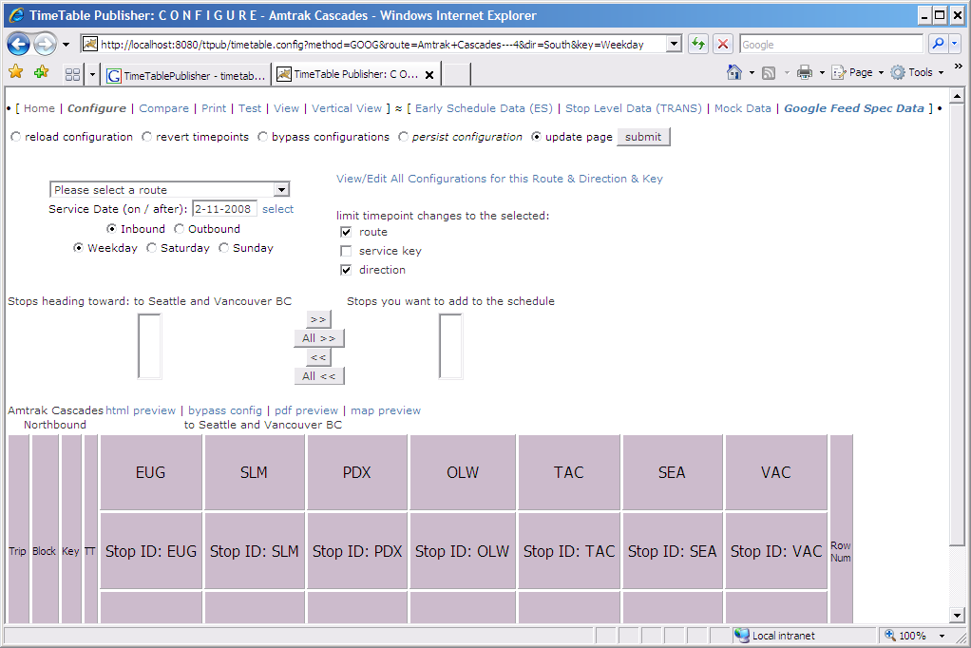
TTPUB – Configure Tool

Slide 17
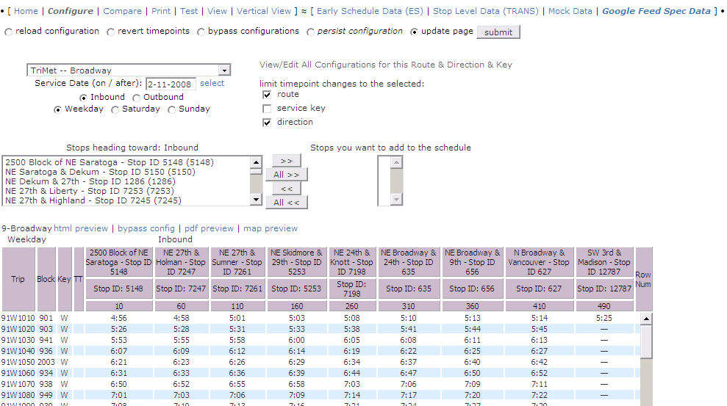
Select a Route to Configure
The Route
pull-down
List of Stops
Titles
Schedule Data

Slide 18
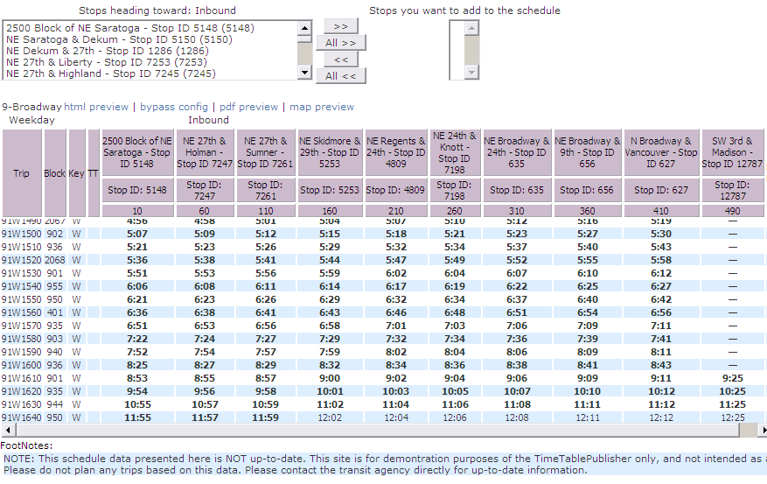
Replace a Stop & Footnote Trips
The last stop on our table only has a handful of times. Let's replace it with an earlier stop that has a full column of stop times.
But let’s also add a footnote to show which trips hit this last stop.
What we're going to do:
Replace the current (sparsely populated) stop and column of times with a better stop.
Add a new stop as a replacement.
Footnote the late-night trips which travel to the last stop. (Note: this configuration will also replace times with our footnoted stop's times).

Slide 19
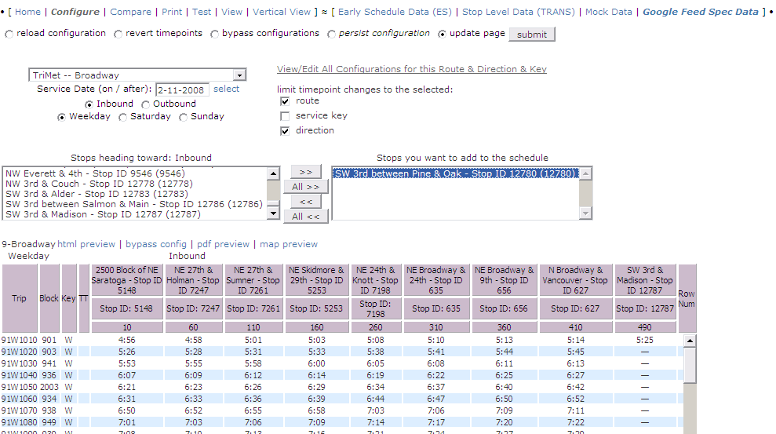
Add a New Stop to the Table
Select our new stop from the stop list.
And add it to the list of stops to be added to the table

Slide 20
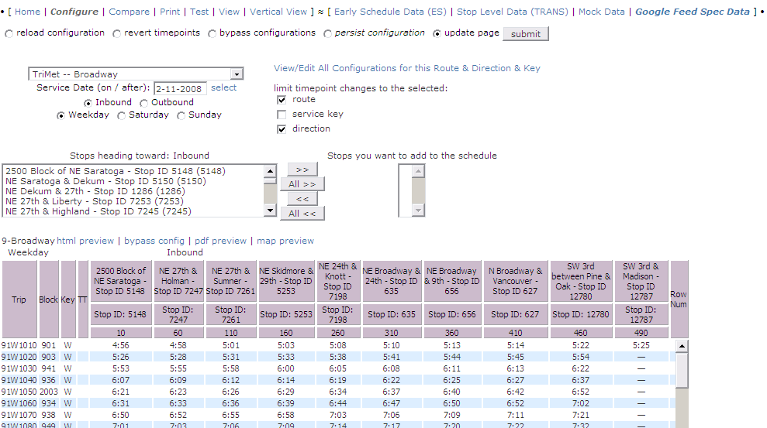
New Stop is Now Added to Table
OK, note that the new stop is added to table.

Slide 21
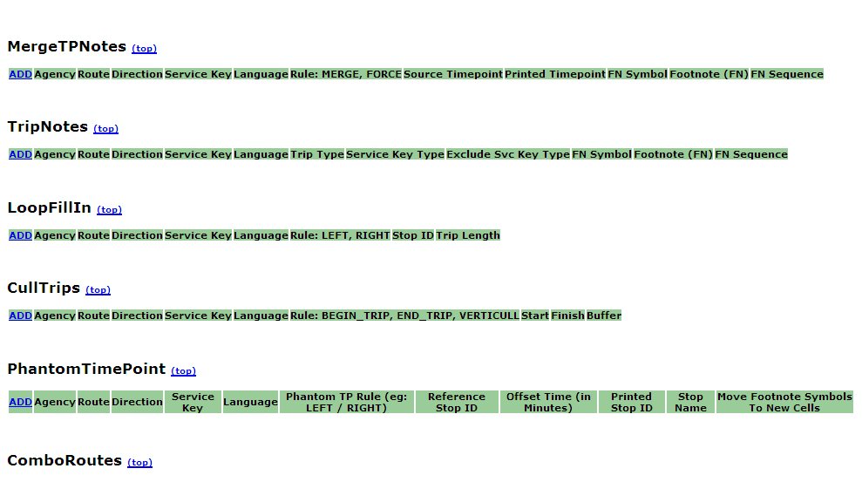
Footnote Trips
Clicking here
will bring up the footnote editor

Slide 22
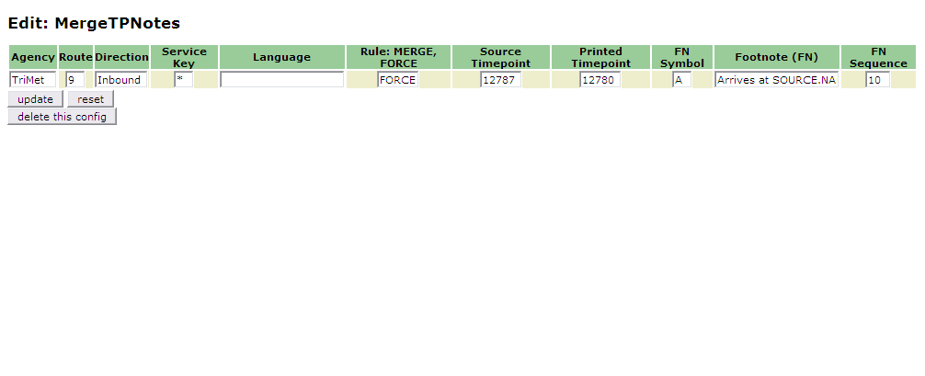
Add a Merge Stops Footnote
So we’re going to add a new MergeTPNotes configuration.
We’ll set the rule to FORCE
The Source Timepoint (the one with only 5 trips that have times) tells the config to mark those trips with a footnote.
The Printed Timepoint will be where the footnote and times get placed into the table.
Finally, the footnote symbol and note content are also part of the configuration.

Slide 23
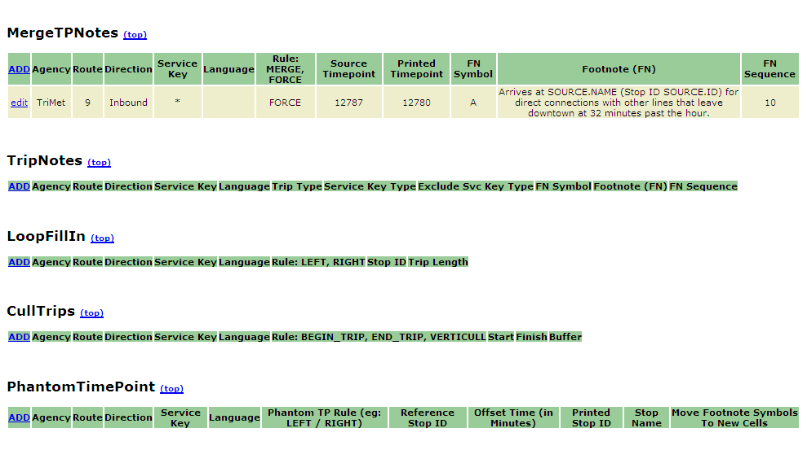
Resulting Configuration

Slide 24

Footnote Added to Table
A footnote is added to table now.

Slide 25
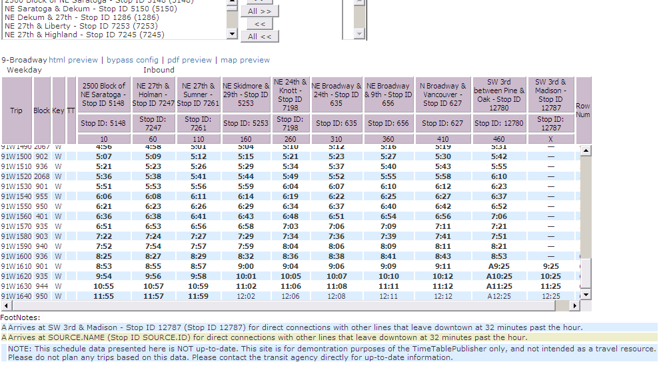
Delete a Stop from TimeTable
X out the stops to be removed from table

Slide 26
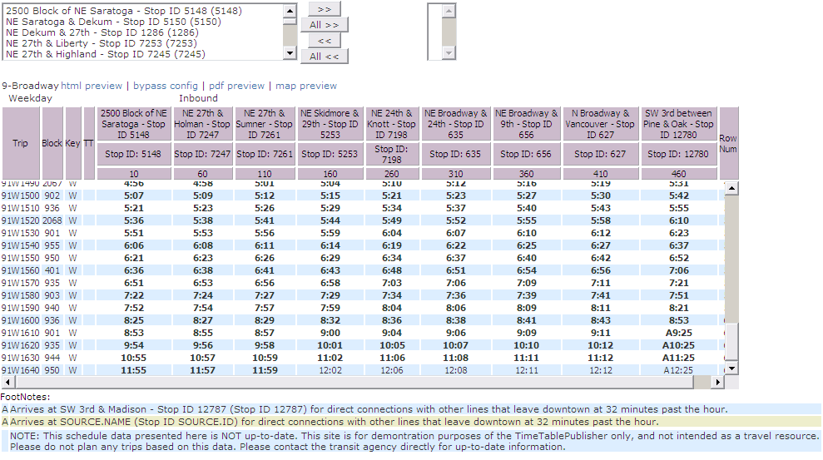
Results: Table with Footnote

Slide 27
Other TTPUB
Tools

Slide 28
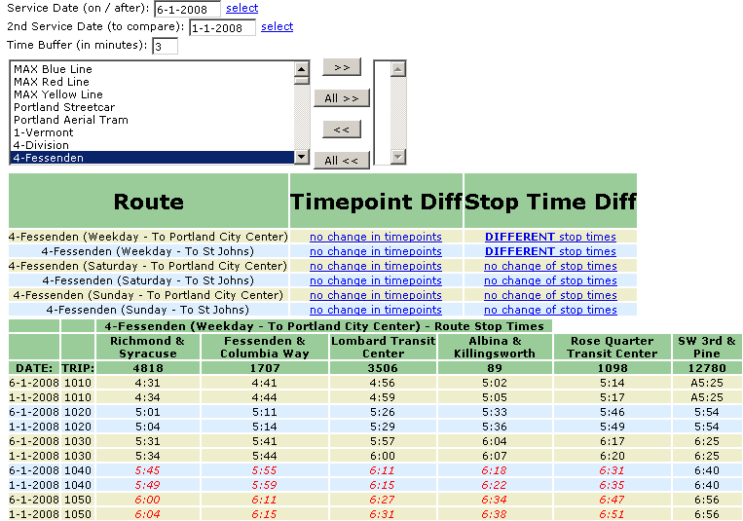
Compare Tool
Two service
dates
Show stop times that exceed the (3 minute) buffer
NOTE: ttpub’s current GTFS loader does not support multiple services being loaded at one time, so the compare tool is not yet usable. That said, it’s a great tool, works when data is sourced from a database (like at TriMet), and with a bit of development work, could work.

Slide 29
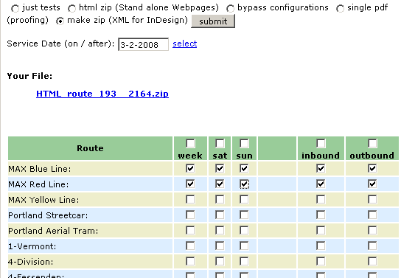
Print Tool
Different output formats include XML, PDF and HTML (wrapped in a ZIP file). Other formats can be created via an industry standard templating tool (Freemarker).
Select either entire schedule, or specific lines to ‘print’

Slide 30
Contact
Frank Purcell
Software Engineer @ TriMet
Geographic Information Systems
4012 SE 17th Ave
Portland, Oregon
purcellf@trimet.org

Slide 31
END

